Slide 1
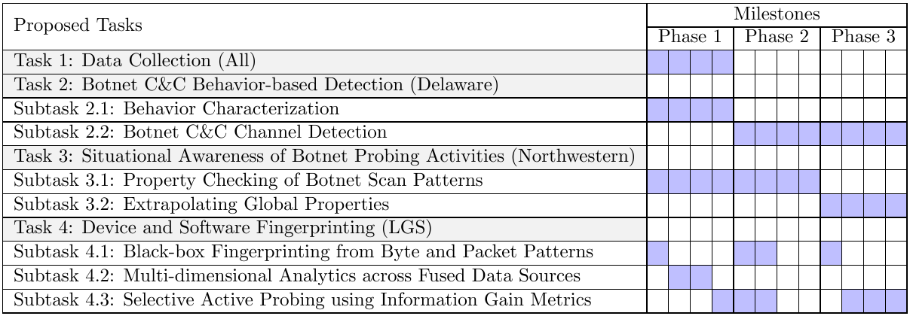
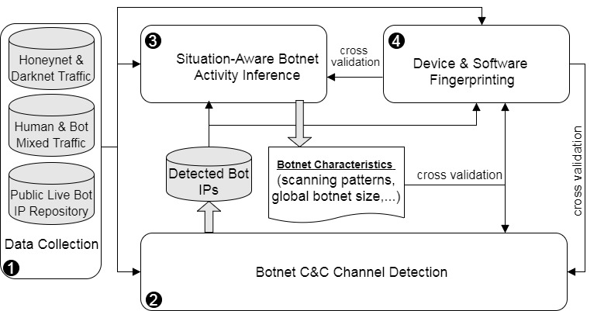
TA1| Northwestern University, LGS Innovations, University of Delaware| Real-Time Detection and Situational-Aware Analysis of Internet-Scale Heterogeneous Botnets| 4.7 Million US Dollars
Descriptive Summary
Key challenges: only local observation of botnet traffic, encrypted botnet traffic, spoofed traffic, devices hidden behind NATs, noisy data sources, blocked probes
Summary of approach: inferring global property using “mark and Recapture” method, black-box fingerprinting using deep learning from byte and packet patterns, fusion of multiple information sources and application of multi-dimensional analytics, and selective action probing using information gain metrics
Confidence in approach is based on successful prior work in each area from DARPA programs and/or IR&D
Risks and mitigations: overfitting/multiple sources of diverse training data; stale sensors/automated on-line adaptation; manual effort / limited feature set to non-engineered features
Team Organization and Schedule
Northwestern Univ (Prime)
Yan Chen, PI
Haitao Xu, Co-PI
LGS Innovations (Sub)
Lloyd Greenwald, PI
Univ of Delaware (Sub)
Haining Wang, PI
Technical Rationale
Behavior-based botnet stealthy C&C channel detection by differentiating between human and bots for network communications and user input events;
Situational awareness of botnet probing activities to infer the botmaster scanning strategy and extrapolate global botnet properties;
Black-box fingerprinting from a limited feature space using deep learning to tackle encrypted botnet traffic for high accuracy and speed without protocol decoding;
Multi-dimensional analytics across fused data sources to find devices hidden behind NATs and aggregated traffic;
Selective active probing using information gain metrics to minimize network overhead and disruption to improve accuracy.
Other Relevant Information
Is any work expected to be fundamental research? Yes
Foreign persons proposed? (if yes, how many?) No
Clearances of team members (list levels and number of personnel with each clearance level) Lloyd Greenwald TS/SCI, and Ed Phelps TS/SCI
Existing classified processing facilities? (Active? Proposed shared? Level? Location?) LGS Innovations has TS rated SCIF in Florham Park, NJ
Intellectual Property (IP) or Data Rights Assertions? (if asserting less than Unlimited Rights) None
Government Furnished Equipment/Materials/ Information (GFE/GFM/GFI) requested? (if yes, then list) None
Human Subject Research (HSR) proposed? N/A

