Slide 1
Compiling Minimum Incremental Update for Modular SDN Languages
Xitao Wen, Chunxiao Diao, Xun Zhao, Yan Chen, Li Erran Li, Bo Yang, Kai Bu
Northwestern University, Tsinghua University, Bell Labs Alcatel-Lucent, Zhejiang University

Slide 2
Motivation
Flowtable update bottleneck
10s to 100s of rule edits per second
Full refresh of 5K entries takes minutes
Goal: minimizing update size to speed up flowtable update
Only update the “diff”

Slide 3
Problem Statement
Update rules whose content or priority changes
3 rule adds + 2 priority updates
Priority updates contribute over 90% in average!
Pattern | Priority
<1, 2> | 3
<*, 2> | 2
<*, *> | 1
Pattern | Priority
<1, 2> | 5
<2, *> | 4
<1, *> | 3
<*, 2> | 3
<3, *> | 2
<*, *> | 1
Priority Updates
Unmodified fields
Modified fields
Old
New
Question: How can we minimize priority updates?

Slide 4
Diff with Reassigned Priority
Idea: Modify priorities assigned by compiler
Challenges:
Constraint 1: New priority assignment MUST observe rule dependency
Solution: Minimum dependency construction
Constraint 2: New priority values MUST be integers within [0, 65535]
Solution: Priority gap maintenance
Pattern | Priority
<1, 2> | 3
<*, 2> | 2
<*, *> | 1
Pattern | Priority
<1, 2> | 5 -> 3
<2, *> | 4 -> 2.5
<1, *> | 3 -> 2
<*, 2> | 3 -> 2
<3, *> | 2 -> 1.5
<*, *> | 1
3 rule edits!
Old
New

Slide 5
Dependency Constraint
Constraint 1: rule dependency
Dependency inferred from priority value is problematic
A
A
 | Pattern | Priority
A | <1, 2, *> | 5
B | <*, 2, 3> | 4
C | <1, *, 4> | 4
D | <1, *, 3> | 3
E | <*, *, 4> | 3
F | <*, *, 3> | 2
 | Pattern | Priority
A | <1, 2, *> | 5
B | <*, 2, 3> | 4
G | <*, 2, 4> | 3
C | <1, *, 4> | 2
D | <1, *, 3> | 3
E | <*, *, 4> | 1
F | <*, *, 3> | 2
B
C
B
X
D
E
D
G
X
F
F
C
Old
New
E

Slide 6
Dependency Constraint
Minimum dependency can be inferred from rule patterns
A
A
 | Pattern | Priority
A | <1, 2, *> | 5
B | <*, 2, 3> | 4
C | <1, *, 4> | 4
D | <1, *, 3> | 3
E | <*, *, 4> | 3
F | <*, *, 3> | 2
 | Pattern | Priority
A | <1, 2, *> | 5
B | <*, 2, 3> | 4
G | <*, 2, 4> | 3
C | <1, *, 4> | 2
D | <1, *, 3> | 3
E | <*, *, 4> | 1
F | <*, *, 3> | 2
B
C
B
D
E
D
G
F
F
C
Old
New
E

Slide 7
Dependency Constraint
With minimum dependency graph, one can always generate minimum-size flowtable update if priority value is continuous
A
A
 | Pattern | Priority
A | <1, 2, *> | 5
B | <*, 2, 3> | 4
C | <1, *, 4> | 4
D | <1, *, 3> | 3
E | <*, *, 4> | 3
F | <*, *, 3> | 2
 | Pattern | Priority
A | <1, 2, *> | 5
B | <*, 2, 3> | 4
G | <*, 2, 4> | 3-> 4.5
C | <1, *, 4> | 2 -> 4
D | <1, *, 3> | 3
E | <*, *, 4> | 1 -> 3
F | <*, *, 3> | 2
G
B
C
B
C
D
E
D
E
F
F
Take-away: Minimum dependency helps eliminate priority updates

Slide 8
How to obtain minimum dependency
Restored from prioritized flowtable after compilation
Incurs complicated header space computation
Constructed along with compilation
Rule dependency can be recursively inferred from policy composition process
Incurs little additional overhead over compilation
* Find the algorithm description and the complexity analysis in our technical report at http://goo.gl/gBLBrm

Slide 9
Incremental Dependency Construction
Recursive construction of minimum dependency
Extend intermediate flowtables with dependency graph
Keep track of dependency during compilation
Parallel composition
Sequential composition
>>
Composition Operators
P9
>>
>>
|
>>
P6
>>
P6
P8
P1
P2
P3
|
P3
P7
P4
P5
Intermediate
Flowtables

Slide 10
Incremental Dependency Construction
Infer dependency for parallel composition
Graph cross-product
Intersection tests
Special treatment for compiler-specific data structure
Sequential composition is similar except for the actions of the first operands

Slide 11
Maintaining Priority Value Distribution
Constraint 2: discrete priority values
Integers ranging [0-65535] for OpenFlow
If new rule is inserted between adjacent priority values, we have to shift existing rules to make room for them
Problem Statement
Assign priority values for priority levels
Objective: minimize the estimation of priority shifts
Online strategy
Undetermined future policy update sequence
Pattern | Priority
<1, 2> | 5 -> 3
<2, *> | 4 -> 2.5
<1, *> | 3 -> 2
<*, 2> | 3 -> 2
<3, *> | 2 -> 1.5
<*, *> | 1

Slide 12
K-factor strategy
Key idea: proactively maintains the ratio between max priority gap and min priority gap
Initiation
Distribute priority levels evenly on [0-65535]
Invariance
Keep lengths of all gaps between [1/k, k] * mean length, where k is a parameter
Cost
Amortized: O(1) per update
F
D
B
A
E
C
G
0
8
30
40
60
80

Slide 13
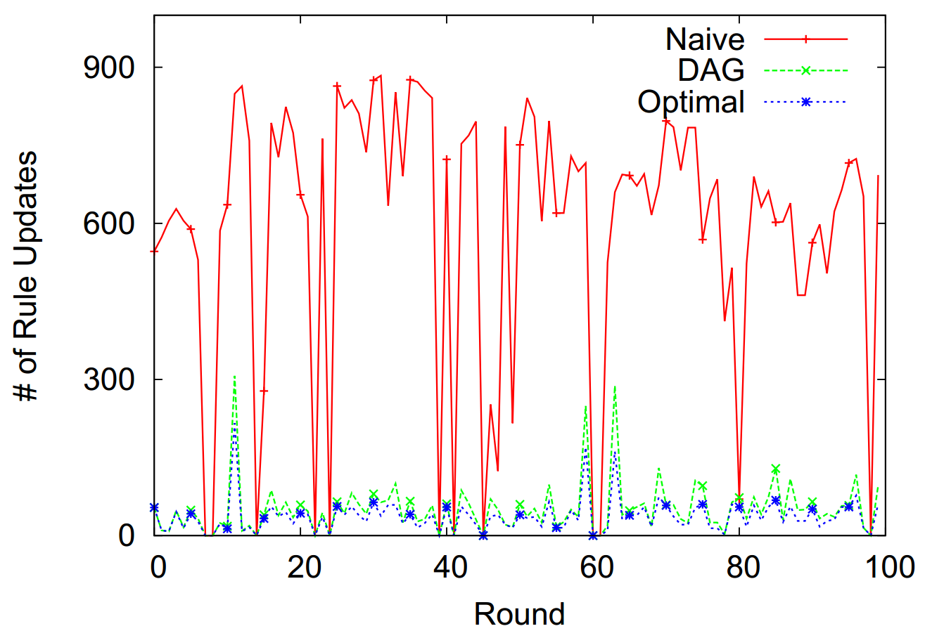
Evaluation
Diff
Dependency
Optimal
Eliminates almost all priority updates
10x smaller on average compared to diff

Slide 14
Conclusion
Minimum incremental update framework comprising of
Minimum update generation with dependency
K-factor strategy for priority gaps maintenance
Future work
Dependency construction algorithms generic to policy languages
Lower bound of priority gap maintenance

Slide 15
Question?
Xitao Wen
xitaowen2015@u.northwestern.edu

