Slide 1
APTShield: Real-time RAT-based Detection for Engagement 2

Slide 2
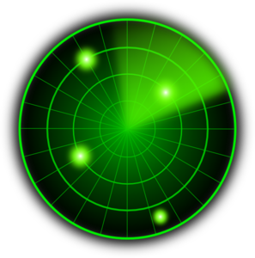
Our Focus
Initial Compromise
Gaining Foothold
Lateral Movement
High Value Asset Acquisition
Malware (e.g. RAT)
Phishing
Exploit
vulnerability
Network scan
Code Repo
Malware
propagation
Attacker
Victim
CONFIDENTIAL
Malicious
Web
Exploit
browser
Database
Behavior based Malware detection
Design a detection mechanism that targets at the post-compromise steps in the APT life-cycle

Slide 3
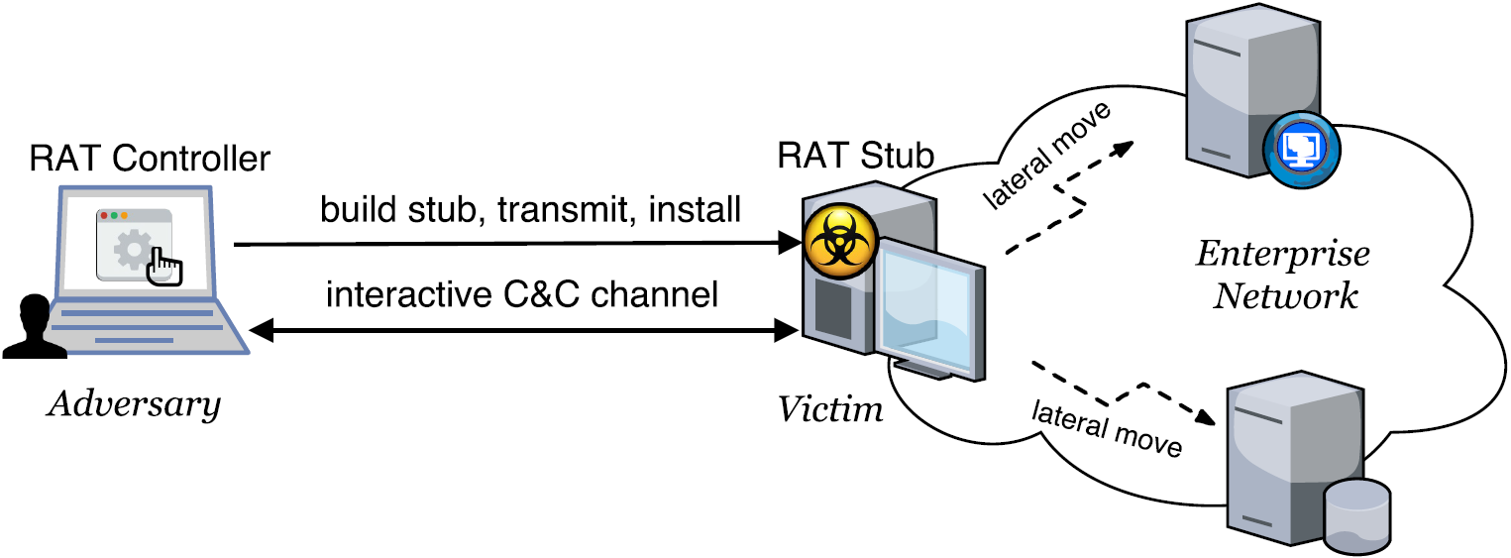
Background about APT Malware
Remote Access Trojan (RAT)
A complex set of potentially harmful functions (PHFs)
E.g., keylogger, screengrab, remote shell, audiograb
A Windows RAT typically embodies10~40 PHFs.

Slide 4
Basic Idea
Observations
Ways of implementing a PHF are limited too, in terms of
Core system calls & parameters , and such sequences to exactly define a PHF
→ Possible to define each PHF using system call sequences
Propose PHF-based RAT detection when a program exhibits
A sufficient number of PHFs
RAT-specific resource access characteristics
Advantages: evasion-resilient and semantic-aware
Hard to evade unless attackers find new ways of implementing PHFs
Per PHF detector; semantic-aware; know exactly what activity is going on
Notes:
function-level, ground truth, supervised training,
is a must for adversaries to implement a PHF
A PHF could be exactly defined by a limited set of core system calls.
Separation of signatures for PHFs increases the detection specificity by combining different types of signatures
In each signature sequence, the core system calls are irreplaceable, and the order must be preserved to implement a p

Slide 5
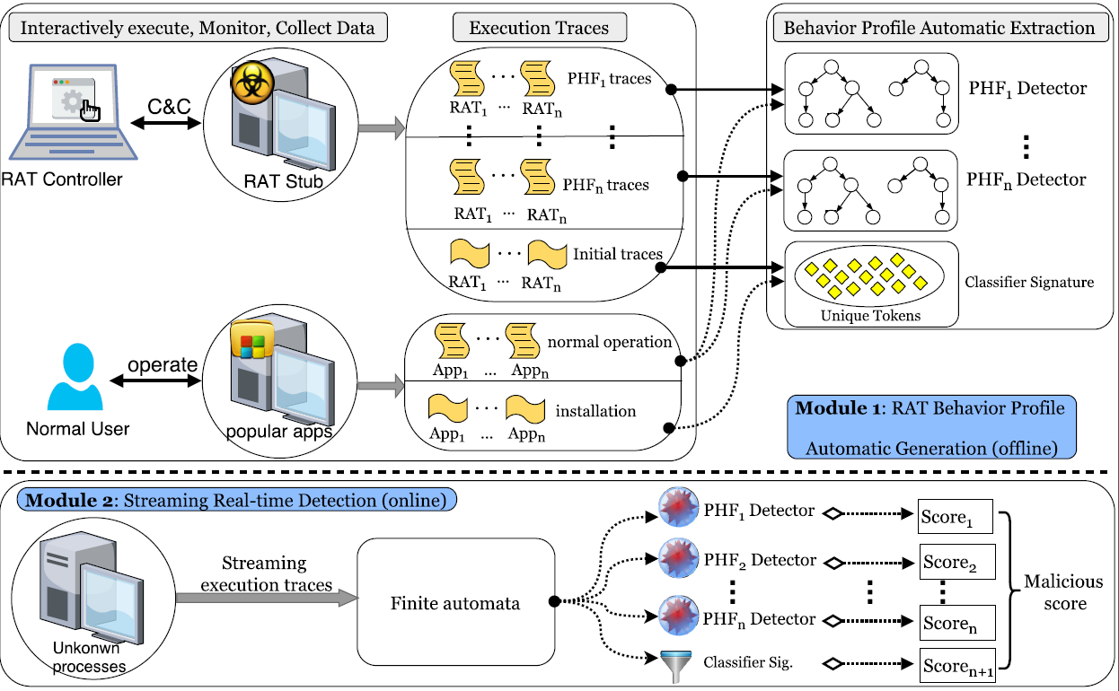
System Architecture
Notes:
function-level, ground truth, supervised training
Generated signatures for both determining the functionality and discerning between malicious and benign

Slide 6
Progress Towards Engagement 2
Notes:
Progress Towards Engagement 2

Slide 7
Engagement 2 Model
Quote from TA 5.1 Jan PI meeting slides
1. Allocates memory and writes module to it
APT
process
Host
process
netrecon
2. Executes module in memory
Notes:
specifically including randomly inserting branches within a basic block, reordering instructions, encrypting string variables, and dummy code insertion

Slide 8
Focus on Reflective DLL Injection
Reflective DLL Injection
A library injection technique, using the concept of reflective programming to load of a library from memory into a host process
Two stages: code injection and reflective loading
Notes:
specifically including randomly inserting branches within a basic block, reordering instructions, encrypting string variables, and dummy code insertion

Slide 9
Reflective DLL Injection – Stage 1
Stage 1: Code Injection
Performing in the APT process
Goal: the attacker injects the malicious DLL into the target process, and gets the code execution in the target process
Step 1: select target process
Step 2: allocate memory in the target process
Step 3: write the malicious library into the allocated memory
Step 4: create a thread in the target process, e.g., using CreateRemoteThread
Notes:
specifically including randomly inserting branches within a basic block, reordering instructions, encrypting string variables, and dummy code insertion

Slide 10
Reflective DLL Injection – Stage 2
Stage 2: Reflective Loading
Performing in the target process
Now, the execution is passed to the library's ReflectiveLoader function
Goal: relocate the malicious library to a suitable location in memory, and resolve its imports so that the library's run time expectations are met
Notes:
specifically including randomly inserting branches within a basic block, reordering instructions, encrypting string variables, and dummy code insertion

Slide 11
Reflective DLL Injection – Stage 2: Step 1
Target process
Calculate its own image’s current location
Loader Function
Malicious Code

Slide 12
Reflective DLL Injection – Stage 2: Step 2
Calculate the addresses of three functions required by the loader, namely LoadLibraryA, GetProcAddress and VirtualAlloc by parsing the host processes kernel32.dll export table
Target process
GetProcAddress
VirtualAlloc
LoadLibraryA
Loader Function
Malicious Code

Slide 13
Reflective DLL Injection – Stage 2: Step 3
Target process
GetProcAddress
VirtualAlloc
LoadLibraryA
Allocate a continuous region of memory and copy the library's headers and sections into their new locations
Loader Function
Malicious Code
Loader Function
Malicious Code

Slide 14
Reflective DLL Injection – Stage 2: Step 4
Target process
GetProcAddress
VirtualAlloc
LoadLibraryA
Parse the newly loaded copy of its image's import table, load any additional library
Import Table
Loader Function
Malicious Code

Slide 15
Reflective DLL Injection – Stage 2: Step 5
Target process
GetProcAddress
VirtualAlloc
LoadLibraryA
Call its newly loaded image's entry point function, DllMain with DLL_PROCESS_ATTACH, and now the library has been successfully loaded into memory
Import Table
DLL Main
Loader Function
Malicious Code

Slide 16
Focus on Reflective Loading
Understanding Reflective Loading
Stage 2: Loader function (performing in the target process): Take care of all the details involved in manually executing DLLs from memory (relocation).
In fact, the manual DLL execution is equivalent to the function of LoadLibrary used in regular code injection.
Notes:
specifically including randomly inserting branches within a basic block, reordering instructions, encrypting string variables, and dummy code insertion

Slide 17
Detecting Reflective DLL Injection
Basic ideas
Each stage could be defined as a sequence of key steps
Identifying those key steps means detecting each of the two stages
Consider each stage as a PHF
Notes:
specifically including randomly inserting branches within a basic block, reordering instructions, encrypting string variables, and dummy code insertion

Slide 18
Experiment Methodology
Perform reflective loading-based attacks and collect our own data
Leverage two existing implementations:
Stephenfewer’s implementation*, the first one ever
Metasploit’s built-in function, located at post/windows/manage/refective_dll_inject
Experiment details:
Select a target process and get its PID
Perform attacks with either one implementation mentioned above
E.g., executing< inject.exe targetPID>
Monitor the execution of the original target process, as well as both the after-injection target process and the APT process, and collect traces
* https://github.com/stephenfewer/ReflectiveDLLInjection
Notes:
specifically including randomly inserting branches within a basic block, reordering instructions, encrypting string variables, and dummy code insertion

Slide 19
Experiment Methodology – cont’d
Extract behavior graphs using sequence alignment algorithm
Perform comparative analysis between
traces invoked by the original target process vs. traces invoked by both the after-injection target process and the APT process
To extract unique behavior graphs that appear in after-injection traces while not in original target process traces
* https://github.com/stephenfewer/ReflectiveDLLInjection
Notes:
specifically including randomly inserting branches within a basic block, reordering instructions, encrypting string variables, and dummy code insertion

Slide 20
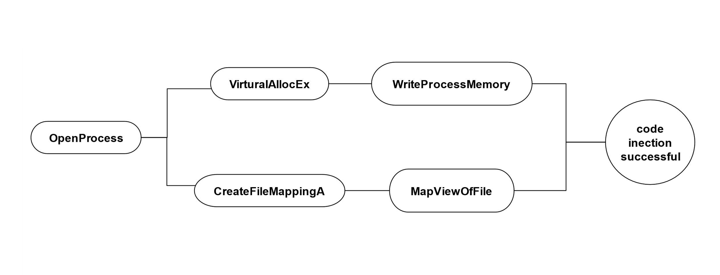
A Simplified Behavior Graph Extracted for Injection Stage
Notes:
specifically including randomly inserting branches within a basic block, reordering instructions, encrypting string variables, and dummy code insertion

Slide 21
Details about Behavior Graph Extracted for Injection Stage
Semantics | System Calls | Parameters
Step 1: select target process | NtOpenProcess | ProcessHandle, DesiredAccess=AllAccess
Step 2: allocate Memory in target process | NtAllocateVirtualMemory | ProcessHandle, BaseAddress, RegionSize, Protect=PAGE_EXECUTE_READWRITE
Step 3: write malicious data | NtWriteVirtualMemory | ProcessHandle, BaseAddress, Buffer, NumberOfBytesToWrite=RegionSize
Step 4: flush execution cache for specified region of code | NtFlushInstructionCache | ProcessHandle, BaseAddress, NumberOfBytesToFlush
Step 5: create thread to execute malicious code | NtCreateThreadEx | ProcessHandle, ThreadHandle
Reference: MSDN, undocumented.ntinternals.net
Notes:
specifically including randomly inserting branches within a basic block, reordering instructions, encrypting string variables, and dummy code insertion

Slide 22
Details about Behavior Graph Extracted for Reflective Loading Stage
Semantics | System Calls
Calculate its own image's current location | -
Locate kernel32.dll export table to get the address of three functions | NtQueryInformationProcess(API call: LdrGetProcedureAddress, RtlInitString)
Allocate a continuous region of memory into which it will proceed to load its own image. | NtAllocateVirtualMemory
Library's headers and sections are loaded into their new locations in memory | NtCreateSection
 | NtMapViewOfSection
Process the newly loaded copy of its image's import table. Loading any additional librarys | NtQueryInformationProcess(API call: LdrGetProcedureAddress, RtlInitString)
Process the newly loaded copy of its image's relocation table | -
Call its newly loaded image's entry point funcion | -
Return execution | -
The loader function stage is much more complex than the injection stage.
Notes:
specifically including randomly inserting branches within a basic block, reordering instructions, encrypting string variables, and dummy code insertion

Slide 23
Detection Result
Overall dataset: 14 injection stage traces, 10 loader stage traces, 2222 other traces
Training set: 7 injection stage traces, 6 loader stage traces
Test set: 7 injection stage traces, 4 loader stage traces
TP:
Injection stage: 6/7
Loader stage: 4/4
FP: 0/2222
Notes:
specifically including randomly inserting branches within a basic block, reordering instructions, encrypting string variables, and dummy code insertion

Slide 24
Approach for Five Directions Data

Slide 25
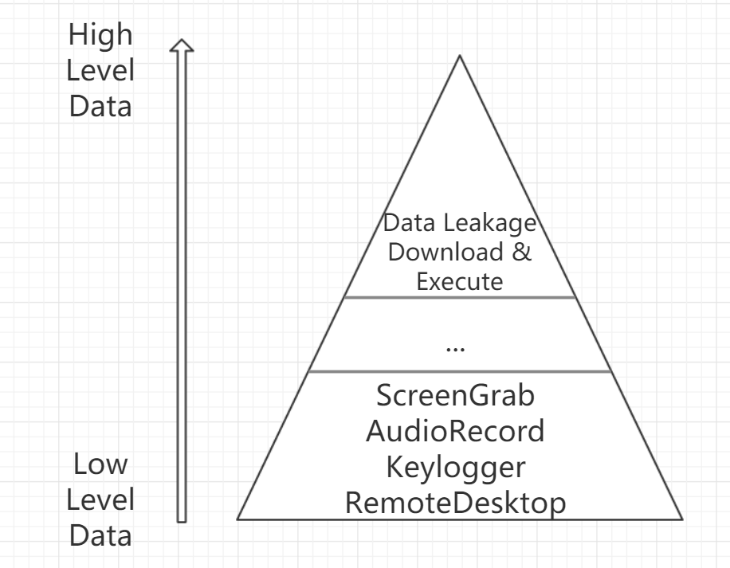
Five Directions VS FAROS data
Higher Level
File Operations
Process Operations
Registry Operations
Network Operations
IPC
…

Slide 26
Method
Problem Definition How to apply our PHF method on the high-level event data provided by 5D?
Solution
High-level events focus on data transmission.
We define several high-level behaviors as our alternative PHFs
download & execute，data-leakage, …
Use event sequence/graph to profile each PHF.

Slide 27
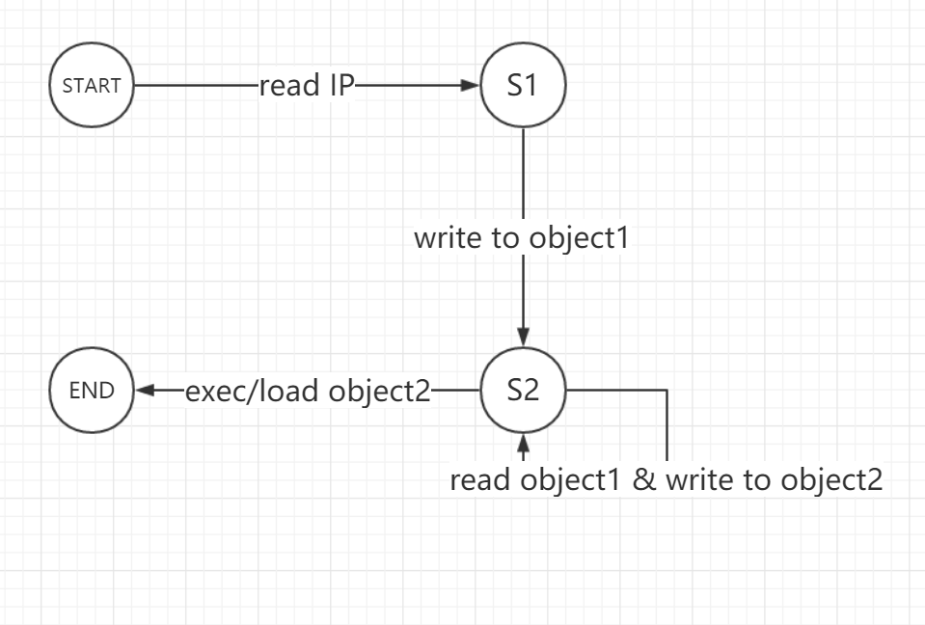
Download & Execute
Subject1 receives contents from IP 112.32.12.145 and writes to file1
Subject2 reads file1 and writes to memory section1.
Subject3 reads memory from memory section1 and writes to file2.
Subject4 loads a library from file2
Now we can detect the Download & Execute behavior in Engagement 1 traces.

Slide 28
Detection Result
Test against Five Directions Engagement 1 Bovia Scenario
38,880 processes in total
Ground truth: 38876 benign processes, 4 processes exhibiting download and execution behavior
Result
FP: 5/38876 = 0.013% (java.exe downloads xx.dll for Update, thus FP)
TP: 4/4 = 100%
Based on the 4 identified malicious processes, then perform backward and forward analyses to identify all other malicious processes.

Slide 29
FAROS Data Issues
Notes:
Progress Towards Engagement 2

Slide 30
Issues Summary
Issue 1: Provenance tag per byte will cause too many tags associated with a process (tag explosion)
Issue 2: Introduce too many unnecessary provenance tags
Issue 3: Some fields in CDM traces are given a wrong value while some have no values (null)
Notes:
specifically including randomly inserting branches within a basic block, reordering instructions, encrypting string variables, and dummy code insertion

Slide 31
Provenance Tag Explosion AND Incorrect Provenance (1)
Provenance tag per byte → tag explosion
Maximum # of tags associated with a process = (# system calls) x (avg # arguments) x (avg # bytes)
Too many unreasonable provenance tags → many wrong relationships between processes
Notes:
specifically including randomly inserting branches within a basic block, reordering instructions, encrypting string variables, and dummy code insertion

Slide 32
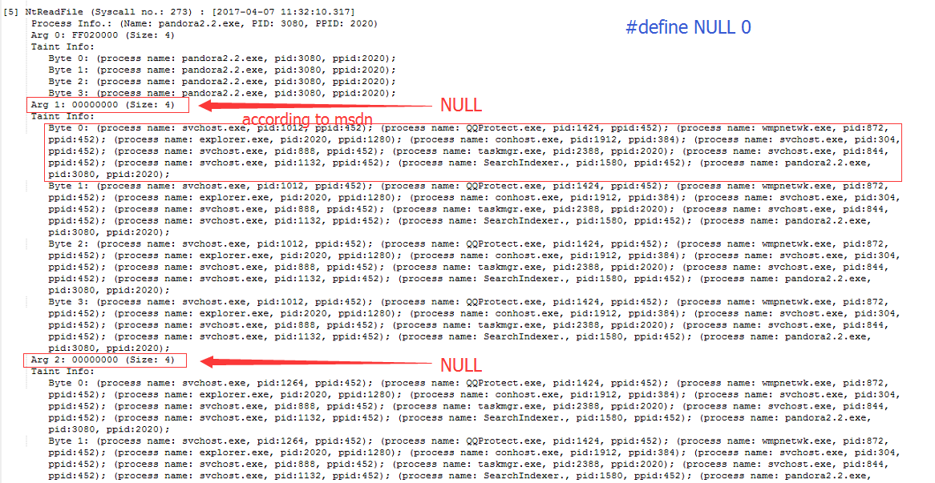
Provenance Tag Explosion AND Incorrect Provenance (2)
Notes:
specifically including randomly inserting branches within a basic block, reordering instructions, encrypting string variables, and dummy code insertion

Slide 33
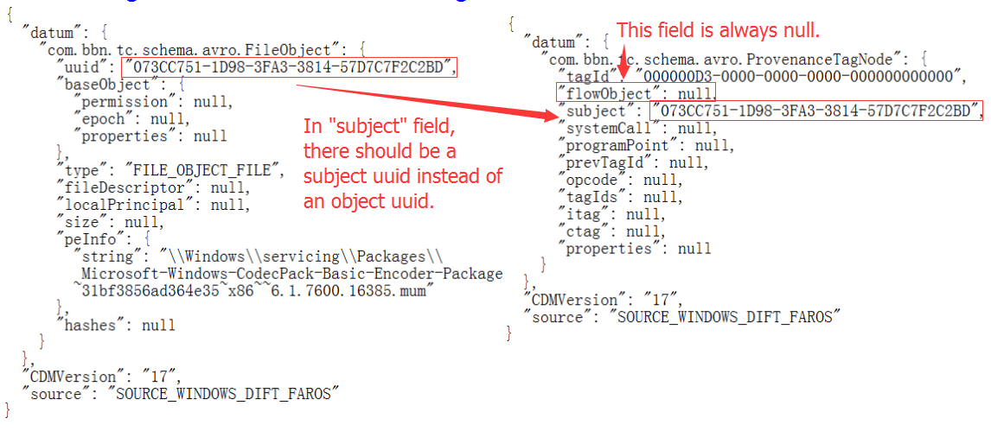
Incorrect CDM Representation
Assign a subject field with the value of an object
Important but optional fields are all missing (e.g., ppid is null)
Notes:
specifically including randomly inserting branches within a basic block, reordering instructions, encrypting string variables, and dummy code insertion

Slide 34
What We Do with Such Bad-formatted and Defective Data?
The FAROS team has not been responsive since Jan PI meeting
We have contacted FAROS but got no response
IBM’s Tau-calculus cannot perform automatic graph traversal on FAROS data
We at Northwestern will make extra efforts to extract useful information and construct graph, as we did in Engagement 1
Achieve automatic graph construction based on file objects, netflow objects, and child-parent relationships, and perform automatic tracking
Notes:
specifically including randomly inserting branches within a basic block, reordering instructions, encrypting string variables, and dummy code insertion

Slide 35
Additional Evaluation on Windows System Call Data Beyond Engagement 2

Slide 36
RAT Collection
80 RAT controllers are collected from underground hacker forums
Those controllers were cracked and shared in several hacker forums
Each RAT controller could be considered from a unique RAT family, given
Each one is unique in terms of its GUI, the combination of functionalities, and the malware author.
Those controllers are quite notorious and have been involved in famous security incidents in the recent years.
Iran nuclear facility attack, Sony hack, RSA data theft, …
Notes:
RAT-initialization and RAT-per-functionality: 1,271,049 and 5,080,212 system calls

Slide 37
Evaluation of Detection Capability
Experiment 1: Per-PHF traces collected on our own
80 RATs in total = 40 RATs used for training + 40 for test
Capture 80 initialization traces and 560 (i.e., 80*7) per-PHF traces for each RAT → 1,271,049 and 5,080,212 system calls, respectively
Results: 97.9% detection accuracy
Experiment 2: Third-party (from Univ. of New Mexico) benign traces
More than 21 million system calls invoked by 422 processes, corresponding to 27 unique benign applications
Results: 2 false alarms that the two applications Word and Excel performed keylogging operations. No false alarms after initialization signatures are applied.
Notes:
RAT-initialization and RAT-per-functionality: 1,271,049 and 5,080,212 system calls

Slide 38
Evaluation of Detection Capability – cont’d
Experiment 3: Benign traces collected on our own
Select 31 popular Windows applications and perform RAT-like behaviors;
E.g., operate the browser Firefox to download a software from online, install and run it on the machine, which is a behavior quite similar to the PHF “URL Download”
6,861,915 system calls collected
Test each of the 31 Windows application traces against the all 7 PHF sig, and also apply initialization signature
Results: 3.2% (7 out of 217 test results) false positive rate. ZERO false positive rate after initialization signatures are applied.

Slide 39
Evaluation of Robustness against Evasion Attacks
Piggyback Attack
An RAT injects itself into a benign program and then runs in the background whenever the host program is launched
We create 40 mixed traces of benign and RAT processes
Results: 100% detected
A parasite RAT malware still needs to generate execution traces to accomplish an attack, although its traces may be mixed together with those of the host program.
Notes:
System Call Reordering Attack
Obfuscation Attack

Slide 40
Evaluation of Robustness against Evasion Attacks – cont’d
System Call Injection Attack
An attacker inserts arbitrarily functionality-irrelevant system calls into its execution traces.
Results: our system is robust to such attack by nature.
Our per-functionality behavior graphs do not require the system calls contained to be contiguously located in a trace.
Notes:
System Call Reordering Attack
Obfuscation Attack

Slide 41
Evaluation of Robustness against Evasion Attacks – cont’d
System Call Reordering Attack
An attacker may change the order of system calls in the execution path to fool our system.
However, reordering system calls without affecting the semantics of an original program has quite limited applicability.
Strict semantic logic, and data and control dependencies exist among the system calls events which compose a behavior graph to represent a PHF.
Notes:
specifically including randomly inserting branches within a basic block, reordering instructions, encrypting string variables, and dummy code insertion

Slide 42
Evaluation of Robustness against Evasion Attacks – cont’d
Obfuscation Attack
We used a powerful obfuscation tool to perform a series of control flow and data flow obfuscation techniques on RAT samples.
Results: Our system is able to detect all of them, while 35 out of 55 VirusTotal scanners fail to detect them.
Notes:
specifically including randomly inserting branches within a basic block, reordering instructions, encrypting string variables, and dummy code insertion

Slide 43
Conclusion
We proposed a novel, fine-grained, evasion-resilient and real-time RAT detection approach.
With both third-party traces and various attacks evaluated, our approach has demonstrated very high accuracy in real-time.
Notes:
Fine-Grained, Evasion-Resilient and Real-time RAT Detection

Slide 44
The End

Slide 45
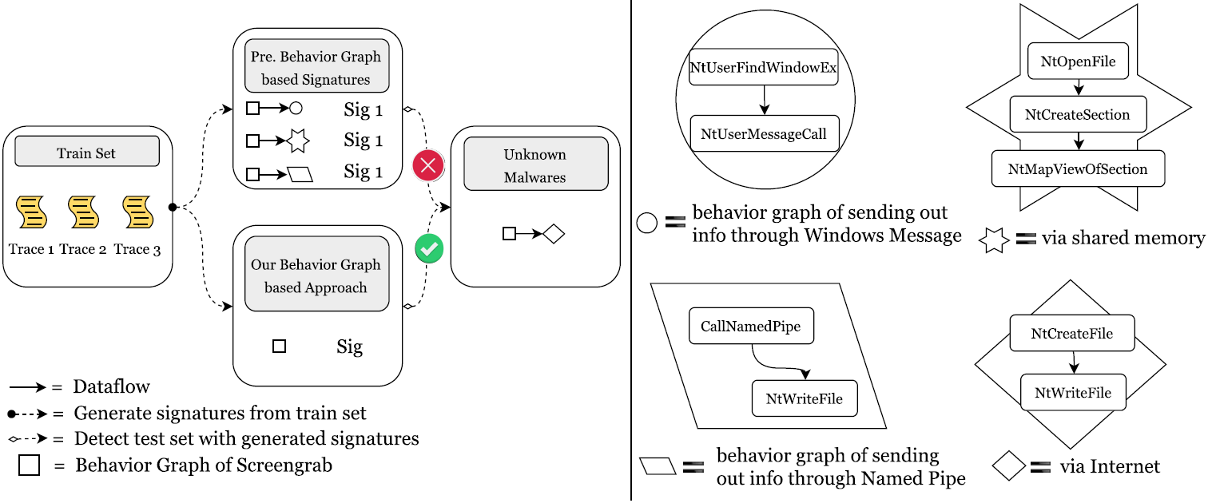
Previous Malware Detection Methods Would Fail RAT Detection

Slide 46
Implementation
Part 1: PHF Detector Generation

Slide 47
PHF Detector Generation - Challenge
Observations
There are limited ways to implement a PHF at the system call level, and RATs tend to implement them quite similarly.
Only quite a small proportion of lengthy malware execution traces are the essential “malicious section”, representing the core function of a PHF
Challenge
How to automatically extract only such essential part from lengthy system call traces to express a PHF?
Notes:
Thus, with tens of RAT samples available, it is feasible to identify all the core system call sequences possibly used for this PHF.
signatures regions of system calls

Slide 48
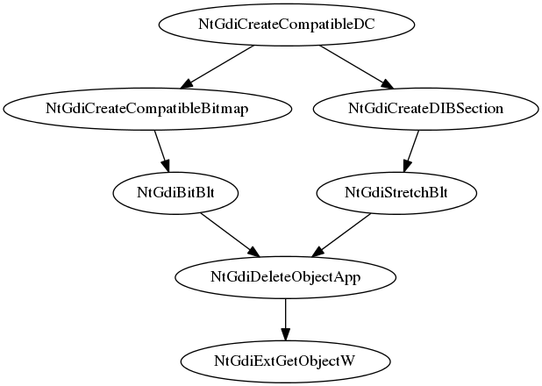
PHF Detector Generation - Solution
Solution
Leverage sequence alignment algorithms borrowed from bioinformatics to identify regions of similarity in system call sequences.
Such similarity regions typically correspond to the execution of similar code.
Build finite automata to model the similarity regions as our PHF detectors
⁞
NtProtectVirtualMemory
NtProtectVirtualMemory
NtGdiCreateCompatibleDC
NtGdiCreateCompatibleBitmap
NtGdiBitBlt
NtGdiDeleteObjectApp
NtGdiExtGetObjectW
NtProtectVirtualMemory
NtProtectVirtualMemory
⁞
⁞
NtDelayExecution NtDelayExecution
NtGdiCreateCompatibleDC
NtGdiCreateDIBSection
NtGdiStretchBlt
NtGdiDeleteObjectApp
NtGdiExtGetObjectW NtDelayExecution NtDelayExecution
⁞
Notes:
Thus, with tens of RAT samples available, it is feasible to identify all the core system call sequences possibly used for this PHF.
signatures regions of system calls

Slide 49
PHF Detector Generation – Solution (cont’d)
Sequence Alignment - Details
Step 1: Local alignment
Preferable when two traces are widely divergent overall but have regions of similarity within long sequences
Tune the classic Smith-Waterman algorithm to take into consideration the data dependencies between system call events and the weight of each event
Step 2: Global alignment
Preferable when the two sequences are similar and of roughly equal size
Tune the Needleman-Wunsch algorithm to our problem
Notes:
Thus, with tens of RAT samples available, it is feasible to identify all the core system call sequences possibly used for this PHF.
signatures regions of system calls

Slide 50
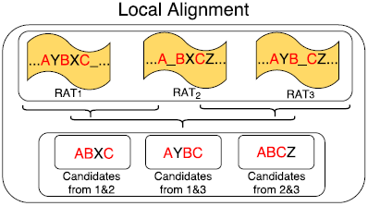
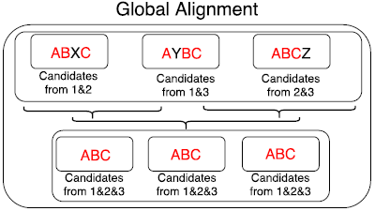
PHF Detector Generation – Solution (cont’d)
Sequence Alignment - Illustration
Notes:
Thus, with tens of RAT samples available, it is feasible to identify all the core system call sequences possibly used for this PHF.
signatures regions of system calls

Slide 51
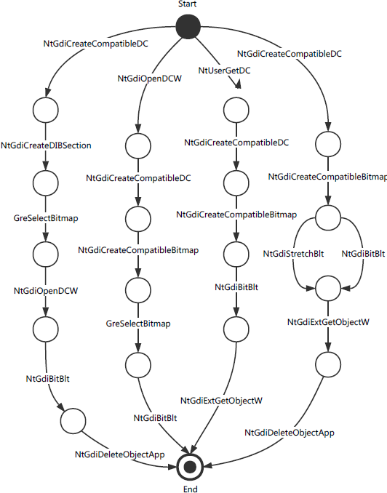
Example of PHF Detector Generated for Screengrab
Screengrab
A path (start, s₁, s₂, …, s_{n}, end) represents one implementation.
Two consecutive system calls in the path are not necessarily consecutive in the trace.
The two system calls must have direct or indirect data flow dependency.
Notes:
function-level, ground truth, supervised training,
is a must for adversaries to implement a PHF
A PHF could be exactly defined by a limited set of core system calls.
Separation of signatures for PHFs increases the detection specificity by combining different types of signatures
In each signature sequence, the core system calls are irreplaceable, and the order must be preserved to implement a
In the rightmost path, NtGdiCreateCompatibleDC
is invoked to create a memory device context (DC); then NtG
diCreateCompatibleBitmap creates a bitmap and place
it in the memory DC; afterwards NtGdiBitBlt copies the
on-screen image into the memory DC; finally, NtGdiExtGet
ObjectW and NtGdiDeleteObjectApp are invoked to do
the rounding-off work, and the task of screen grabbing is completed.

Slide 52
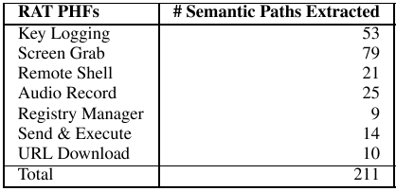
Statistics of PHF Detectors
PHFs currently covered and the number of semantic paths extracted
Key Logging: log all the keys pressed down by the victim and send back to the attacker
Screen Grab: capture the victim’s desktop screen
Remote Shell: remotely open cmd.exe on a victim host and execute arbitrary commands
Audio Record: capture audios with victim’s microphone
Registry Manager: remotely view/modify a victim’s Windows Registry
Send & Execute: upload a local executable file to the victim’s host and automatically execute
URL Download: command the victim to visit a specified website, download an executable file, and then automatically execute it
Notes:
function-level, ground truth, supervised training,
is a must for adversaries to implement a PHF
A PHF could be exactly defined by a limited set of core system calls.
Separation of signatures for PHFs increases the detection specificity by combining different types of signatures
In each signature sequence, the core system calls are irreplaceable, and the order must be preserved to implement a p

Slide 53
Implementation
Part 2: Classifier Signature Generation

Slide 54
Classifier Signature Generation – Greedy Algorithm
Insight
RAT malware often tampers with security-sensitive system settings and registry entries during the initial foothold establishment period while benign programs seldom touch them.
Solution
Develop a greedy algorithm to automatically extract the discriminating tokens which achieve
High coverage: Appear in traces of most RAT malware samples
Near-zero false positive: Seldom appear in traces of benign programs

Slide 55
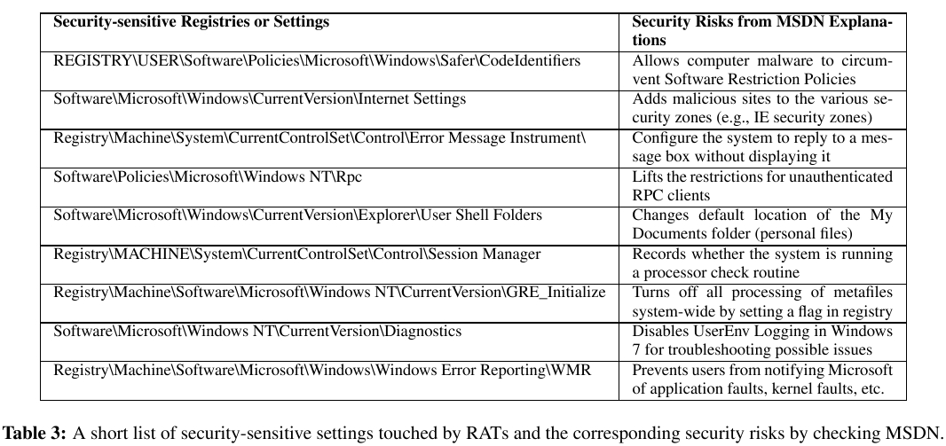
Example of Discriminating Features Extracted
Distinguishing features and their semantics
Notes:
Find the key called “MachineGuid” this key is generated uniquely during the installation of Windows and it won’t change regardless of any hardware swap. It won’t change unless you do a fresh reinstall of Windows. (uniquely Identify A Windows Machine)

