Slide 1
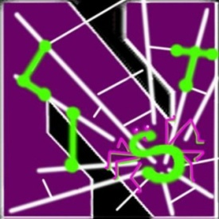
Towards Online Spam Filtering in Social Networks
Hongyu Gao, Yan Chen, Kathy Lee, Diana Palsetia and Alok Choudhary
Lab for Internet and Security Technology (LIST)
Department of EECS
Northwestern University

Slide 2
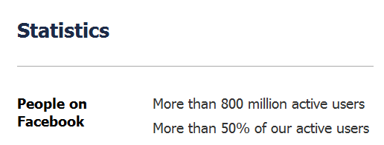
Background
Notes:
Online social network has become extremely popular among Internet users.
Facebook, the largest online social network has 800M active users:
According to Alexa,
1. Facebook is the 2nd most visited website, accounting for about 6% of page views.
2. Twitter is the 9th most visited website, accounting for 0.4% of page views.
With tremendous popularity, online social networks have also attracted attackers. In this study, we target the spam problem.

Slide 3
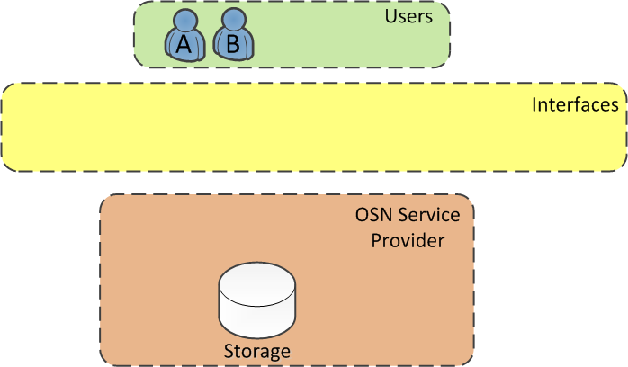
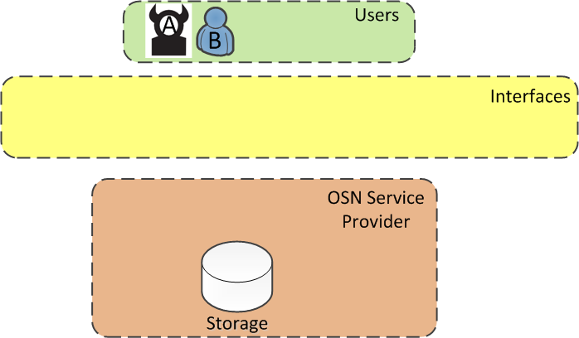
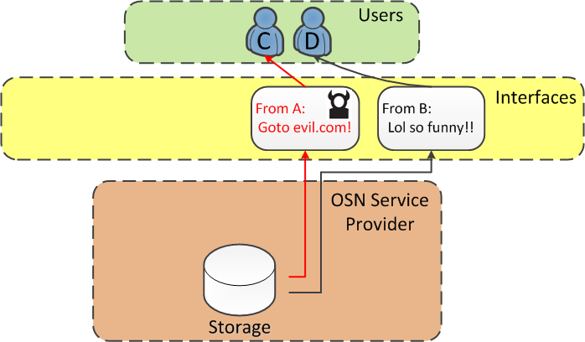
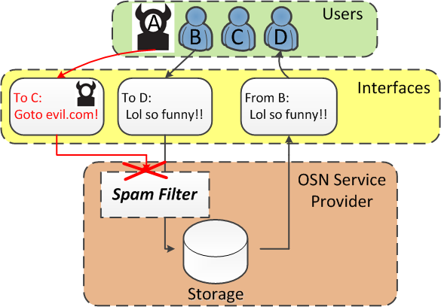
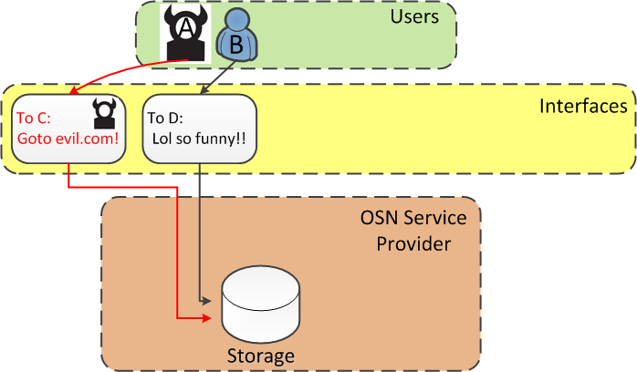
Background
Notes:
1. All commercial Osns adopt client-server architecture. The users interact with each other through well-defined interfaces, and the service provider mediates all interactions.
2. However, not all users are necessarily benign. Suppose we now have a bad user, A, and a legitimate user, B.
3. A sends a spam message to user C, while B sends a legitimate message to user D. In this example a message always has one sender and one receiver. Nowadays a popular way of using a social network is to broadcast a message. For example, messages in Twitter are broadcast to all followers. For simplicity, we treat a broadcast message equivalently as a message sent to each of the recipients.
4. Next, the service provider receives the message and waits for the recipients to sign in.
5. Once the recipients sign in, the service provider renders the messages to them. D receives a legitimate message. It’s fine. C receives the spam and is exposed to various kinds of fraud.
6. Our goal is to design an online spam filter to deploy as part of the OSN platform. It inspects every message before the message is rendered to the recipient.

Slide 4
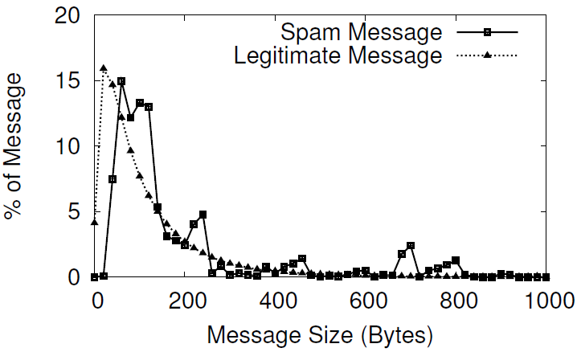
Another Study in Spam Detection??
Unique characteristics of OSNs
Are existing features still effective?
Number of words
Average word length
Sender IP neighborhood density
Sender AS number
Status of sender’s service ports
…
Any new features?
Not effective!
Notes:
The first reason is that OSN is a new environment with a set of unique characteristics. The features that have been proposed in the past need a re-examination before we can assume that they are also effective in OSNs.
For example, message size is proposed to be an effective feature in classifying email spam, because legitimate email has variable length while spam email is usually short. However, in OSNs all messages are short. We conduct a measurement on our social network data, and show the distribution of message size of spam and legitimate messages.
We also evaluated a list of other existing features, including…
A related question is, can we identify any new features that only exist in OSNs, and are effective.

Slide 5
Goals and Existing Work
An effort towards a system ready to deploy
Existing studies in OSN spam:
[Gao IMC10, Grier CCS10] offline analysis
[Thomas Oakland11] landing page vs. message content
Numerous work in spammer-faked account detection
Online detection
High accuracy
Low latency
Detection of campaigns absent from training set
No need for frequent re-training
Notes:
Second, we target at designing a system that can be deployed and protect OSNs in real-time.
….
In addition, we want it to be tolerant for incomplete training data, since we can never collect all spam campaigns to train the system.
At last, the system doesn’t need frequent re-training, which lowers the maintenance cost after deployment.
There is an abundance of work in OSNs spam study.
Ourselves did a offline spam analysis more than 1 year ago. It received wide media coverage.
Grier et.al. did a similar study and reached similar conclusion.
Thomas et.al deveoped the Monarch system that classifies URLs in real-time to identify spam messages. Our approach is complementary to theirs in the sense that we mainly use information in the messages and the senders, rather than the landing pages.
…
, featured in Wall Street Journal, MIT Technology Review, and ACM Tech News

Slide 6
Roadmap
Detection System Design
Evaluation
Conclusions & Future Work
6
Notes:
6
Next in this talk, I will first give our detailed system design, followed by the experimental evaluation of the system.
After that, I’d like to share some potential future work, and finally conclude this talk.

Slide 7
Key Intuition
We Do NOT:
Inspect each message individually
…
msg_1
msg_2
msg_3
msg_n
Spam??
Spam??
Spam??
Spam??
7
Notes:
7
We first introduce the key intuition behind our system.
A common practice is to inspect each message individually.
Given a stream of messages to be inspected, we start with the first one. Is it spam?
…..
We do no follow this practice, because the features used to detect a single message is relatively easy to be maneuvered by spammers.

Slide 8
Key Intuition
We Do:
Inspect correlated message clusters
Correlated messages??
msg_i
Spam campaign??
msg_j
msg_k
msg_k
8
Notes:
8
Note that this clustering based spam detection has been used in offline spam analysis. However, to the best of our knowledge, it hasn’t been adopted for online spam filtering, mainly due to the overhead associated with the clustering process.

Slide 9
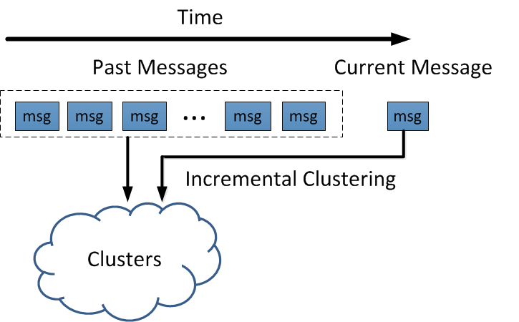
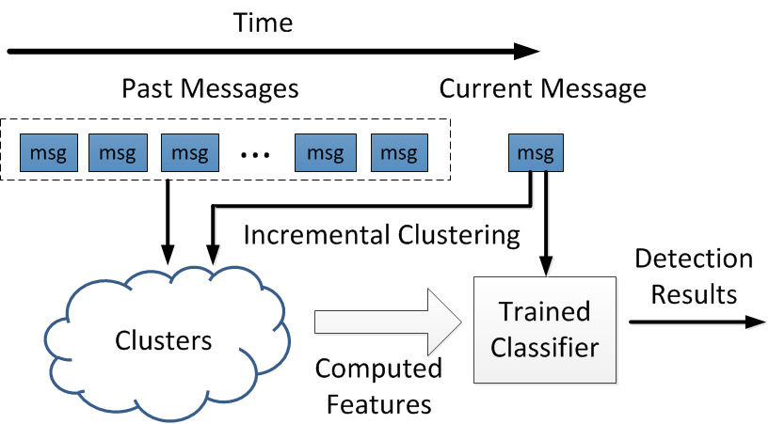
System Overview
Detect coordinated spam campaigns.
Notes:
After deployment, the system sees a stream of incoming messages. There is one new message, and a set of messages that have been observed in the past. The past messages have already been organized into clusters.
The system performs incremental clustering, to update the clustering result given the new message.

Slide 10
Incremental Clustering
Requirement:
Given (k+1)_{th} message and result of the first k messages
Efficiently compute the result of the (k+1) messages
Adopt text shingling technique
Pros: High efficiency
Cons: Syntactic method
Notes:
Incremental clustering requires that the clustering result of (k+1) messages can be obtained by updating the result of the first k messages with the k+1th message. There’s no need to repeat the whole clustering process.

Slide 11
Feature Selection
Feature selection criteria:
Cannot be easily maneuvered.
Grasp the commonality among campaigns.
6 identified features:
Sender social degree
Interaction history
Cluster size
Average time interval
Average URL #
Unique URL #
Notes:
It ensures that it is relatively hard for spammers to manipulate the campaigns to evade detection.
The reason is that some campaigns may be absent in the training set. In addition, after the training phase, new campaigns will emerge. Given these two problems, the features that are specific to any campaigns would have limited effectiveness.

Slide 12
Roadmap
Detection System Design
Evaluation
Conclusions & Future Work
12
Notes:
12

Slide 13
Dataset and Method
Site | Size | Spam # | Time
Facebook | 187M | 217K | Jan. 2008 ~ Jun. 2009
Twitter | 17 M | 467K | Jun. 2011 ~ Jul. 2011
All experiments obey the time order
First 25% as training set, last 75% as testing set.
Evaluated metrics:
Overall accuracy
Accuracy of feature subset
Accuracy over time
Accuracy under attack
Latency
Throughput
13
Notes:
13

Slide 14
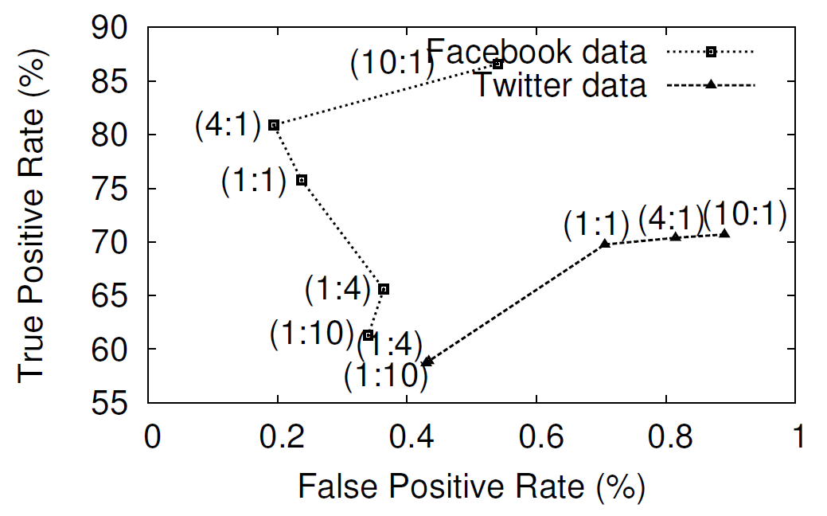
Overall Accuracy
Best result
FB: 80.9% TP 0.19%FP
TW: 69.8%TP 0.70%FP
14
Notes:
14
For the overall accuracy experiments, we vary the ratio of spam to legitimate messages by random sampling. We chose 5 different ratios: 10:1, 4:1, 1:1, 1:4 and 1:10. We repeat the experiment for 3 times, and the result that we present is the average of 3 runs.
The result of Twitter data shows a clear trend, that a larger ratio results in a higher tendency to classify messages as spam. Hence, both the TPR and the FPR increases as the ratio increases.
The result of Facebook data is not so regular. The ratio of 4:1 results in both high TPR and low FPR.
We are not yet clear on why it behaves this way, but…

Slide 15
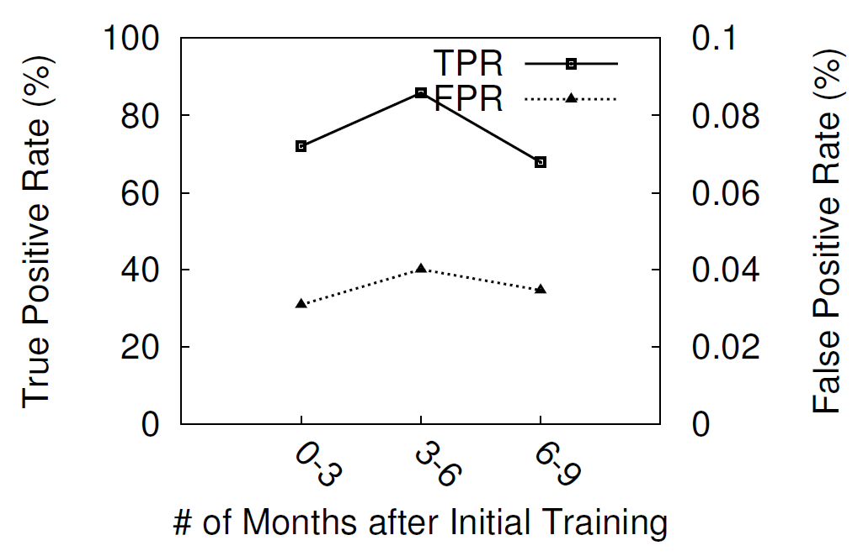
Accuracy over Time
No significant drop of TP or increase of FP
15
Notes:
15
We do an additional experiment to test whether our system stays accurate after a long time after training.
We further divide the Facebook testing set into smaller chunks, which include message generated between 0 and 3 months after training, ….

Slide 16
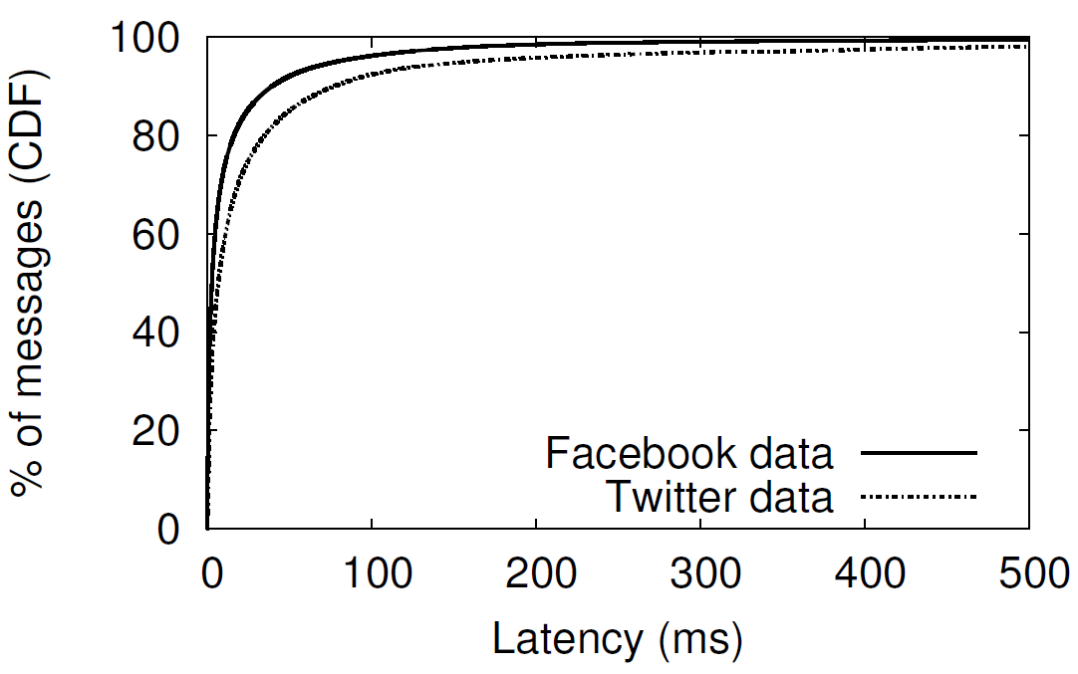
Latency
Latency (ms) | Facebook | Twitter
Mean | 21.5 | 42.6
Median | 3.1 | 7.0
16
Notes:
16
Given that modern browsers spend several hundred milliseconds before they start to render ordinary webpages, we consider the system latency sufficiently low.

Slide 17
Roadmap
Detection System Design
Evaluation
Conclusions & Future Work
17
Notes:
17
Next in this talk, I will first give our detailed system design that tries to detect malicious activities in Online social networks, followed by ….

Slide 18
Conclusions
We design an online spam filtering system based on spam campaigns.
Syntactical incremental clustering to identify message clusters
Supervised machine learning to classify message clusters
We evaluate the system on both Facebook and Twitter data
187M wall posts, 17M tweets
80.9% TPR, 0.19% FPR, 21.5ms mean latency
Prototype release:
http://list.cs.northwestern.edu/osnsecurity/

Slide 19
Future Work
Cool , I by no means noticed anyone do that prior to . {URL}
Wow , I in no way noticed anyone just before . {URL}
Amazing , I by no means found people do that just before . {URL}
Cool | , I | by no means | noticed | anyone | do that | prior to | . {URL}
Wow | , I | in no way | noticed | anyone |  | just before | . {URL}
Amazing | , I | by no means | found | people | do that | just before | . {URL}
Call for semantic clustering approaches
{Cool | Wow | Amazing} + , I + {by no means | in no way} +
{noticed | found} + {anyone | people} + {do that | ε} +
{prior to | just before} + . {URL}
Template generation?
19
Notes:
19
Our key intuition is to classify correlated message clusters, instead of individual messages. but to discover correlated message clusters is not an easy task.
Here I show three sample spam tweets.
…
As intelligent humans, it is apparent to us that they are semantically similar, but syntactically very different. Any syntactic approach is not likely to discover their similarity.
Naturally, it calls for semantic clustering approaches to defeat modern spammers.
I organize the spam tweets into a table. It is even clear to us how spammers generate these messages.
Could template generation be a solution? Maybe. But how to automatically and accurately identify semantically similar spam messages exactly still remains an open question.

Slide 20
Thank you!

Slide 21
Contributions
Design an online spam filtering system to deploy as a component of the OSN platform.
High accuracy
Low latency
Tolerance for incomplete training data
No need for frequent re-training
Release the system
http://list.cs.northwestern.edu/socialnetworksecurity

Slide 22
Incremental Clustering
…
shingle_1
msg_11
msg_12
msg_13
…
shingle_2
msg_21
msg_22
msg_23
…
shingle_3
msg_31
msg_32
msg_33
…
Compare and Insert
shingle_k
…
msg_new
shingle_j
shingle_i
Notes:
Compare with existing messages by looking up the corresponding position in the shingle table.
After that, the shingle table is updated by appending the new message at the corresponding position.

Slide 23
Sender Social Degree
Compromised accounts:
The more edges, with a higher probability the node will be infected quickly by an epidemic.
Spammer accounts:
Social degree limits communication channels.
Hypothesis:
Senders of spam clusters have higher average social degree than those of legitimate message clusters.
Notes:
Research on modeling epidemics in topological networks indicates that the more edges a node has, with a higher probability it will be infected quickly by an epidemic.
On the other hand, for the accounts created by the spammers, social degree limits the number of users that can see whatever message is posted.

Slide 24
Sender Social Degree
Average social degree of spam and legitimate clusters, respectively.

Slide 25
Interaction History
Legitimate accounts:
Normally only interact with a small subset of its friends.
Spamming accounts:
Desire to push spam messages to as many recipients as possible.
Hypothesis:
Spam messages are more likely to be interactions between friends that rarely interact with before.

Slide 26
Interaction History
Interaction history score of spam and legitimate clusters, respectively.

Slide 27
Other Thoughts
Scalability
300M tweets/day
Map-reduce style and cloud computing?
27
Notes:
27

