Slide 1
Detecting Missing RAT Attacks with Semantics on Windows
Xutong Chen and Yan Chen
Northwestern University

Slide 2
Outline
Overview (APT and RAT)
Motivation (comparison with 5D)
Keylogging case study
Overall flowchart graphs (already have)
System Design: API + discriminative sigs
Evaluation
Keylogging for accuracy: API only, API+discri results
Overhead: speed and memory/CPU consumption

Slide 3
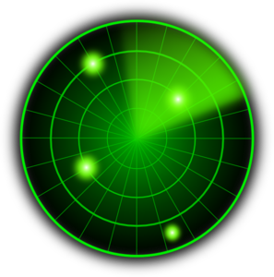
Overview
Initial Compromise
Gaining Foothold
Lateral Movement
High Value Asset Acquisition
Malware (e.g. RAT)
Phishing
Exploit
vulnerability
Network scan
Code Repo
Malware
propagation
Attacker
Victim
CONFIDENTIAL
Malicious
Web
Exploit
browser
Database
Behavior based Malware detection
Design a detection mechanism that targets at the post-compromise steps in the APT life-cycle

Slide 4
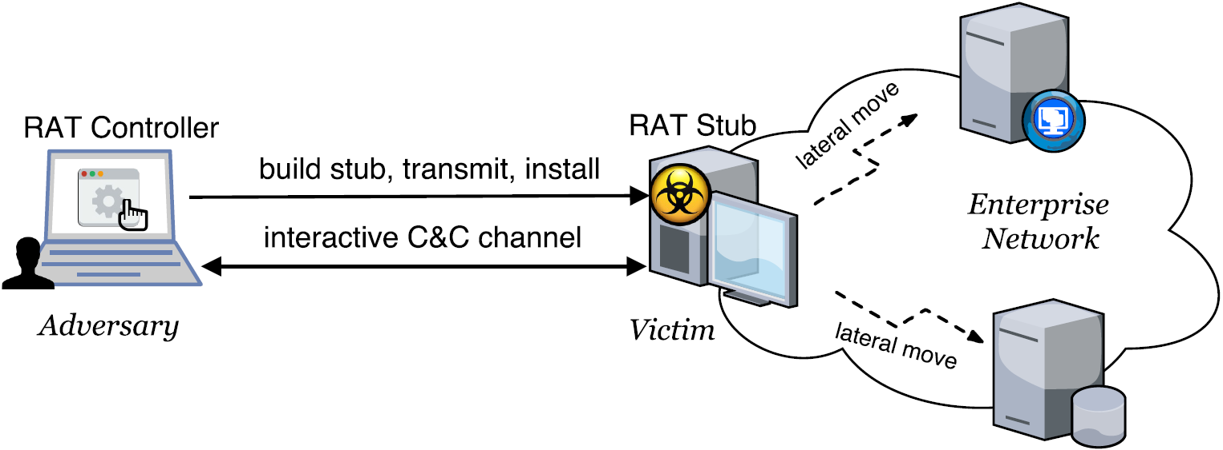
Overview
Remote Access Trojan (RAT)
Based on the study of 300+ APT whitepapers, RAT is a core component in an APT attack, and >90% are Windows based.
Allows an adversary to remotely control a system
A complex set of potentially harmful functions (PHFs)
E.g., keylogger, remote desktop, remote shell, audio grab
A Windows RAT typically embodies10~40 PHFs.

Slide 5
Motivation
Observations
Ways of implementing a PHF are limited too, in terms of
Core APIs & security-relevant events , and such sequences to exactly define a PHF
Propose PHF-based RAT detection when a program exhibits
A sufficient number of PHFs
RAT-specific resource access characteristics
Advantages: evasion-resilient and semantic-aware
Hard to evade unless attackers find new ways of implementing PHFs
Know exactly what activity is going on
Notes:
function-level, ground truth, supervised training,
is a must for adversaries to implement a PHF
A PHF could be exactly defined by a limited set of core system calls.
Separation of signatures for PHFs increases the detection specificity by combining different types of signatures
In each signature sequence, the core system calls are irreplaceable, and the order must be preserved to implement a p

Slide 6
Motivation
Keylogging Case Study
Process of
Keylogging
Data
NU Data（API）
5D Data
GetKeyState
GetKeyboardState
GetKeyboardLayout
ToUnicodeEx
GetForegroundWindow
GetWindowTextW
GetWindowThreadProcessId
WriteFile
Capture
keystrokes
Missing
Capture
foreground
window
information
Missing
Save results
to file
WriteFile

Slide 7
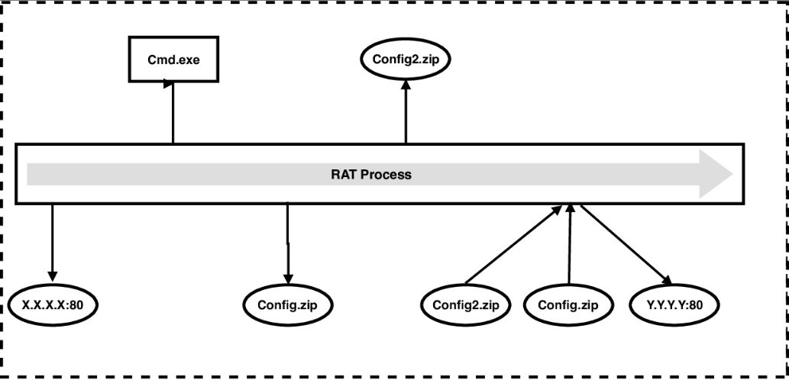
Motivation
Deficiency of Traditional Malware Detection
Even if traditional detection tool captures all artifacts left by the attack, administrators still cannot understand consequences of the attack.

Slide 8
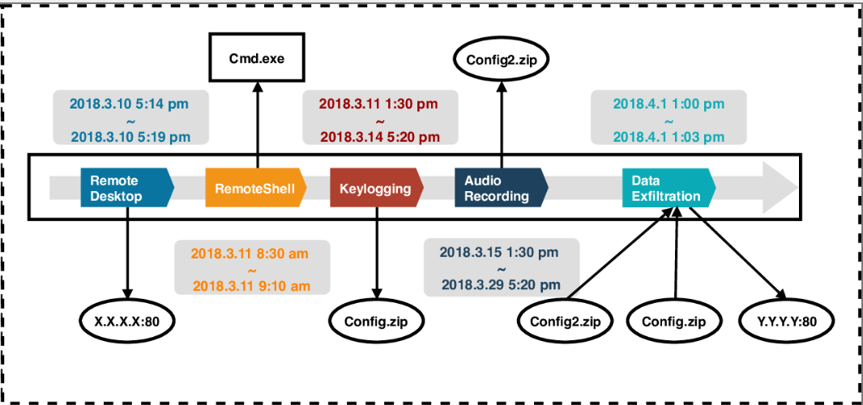
Motivation
Advantage of Our Method
With our semantic-aware detection system, administrators can easily identify fine-grained semantic behaviors and understand consequences of the attack.

Slide 9
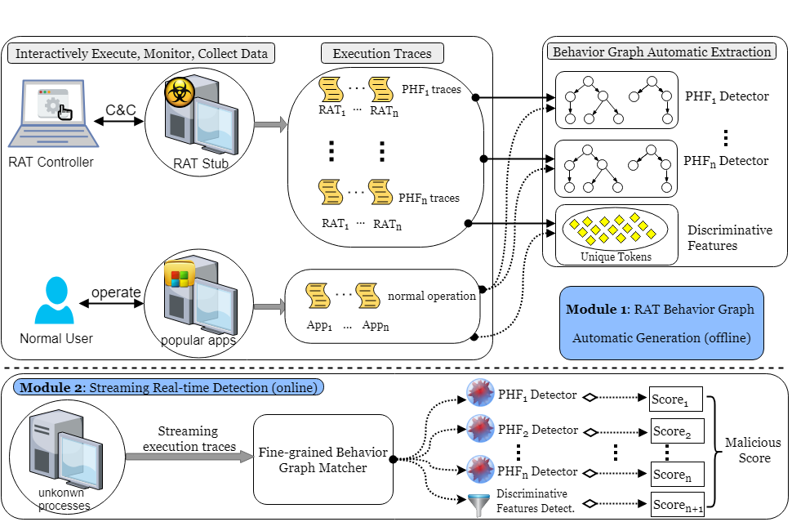
System Design

Slide 10
System Design
Discriminative Features
Discriminative features is used to reduce False Positive, we propose several Discriminative features as follows:
API Types: Assume that a sequence matches a behavior graph, we consider the number of unique APIs, except APIs included in the behavior graph, occurring in the same sequence.
User Interaction: When a process matches a behavior graph, we judge whether there are user interactions on this process.
Network Pattern: The frequency and the payload size of network traffic.

Slide 11
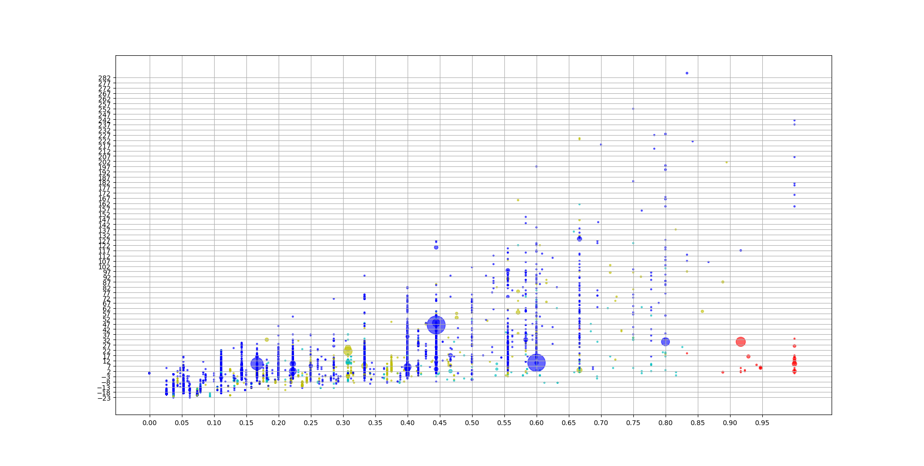
System Design
Discriminative Feature Example on Keylogging
Y axis ：
Normalized # of API Types
Point with other colors is Benign
Red point is RAT
X axis : Graph Matching Score

Slide 12
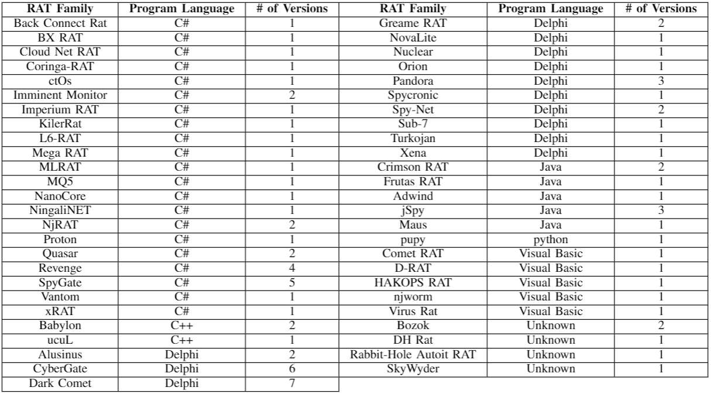
Evaluation

Slide 13
Evaluation
Deploy the system on three physical machines, which last three days.
 | TPR(API only) | TPR(with discriminative features) | FPR(API only) | FPR(with discriminative features)
Keylogging | 89.9% | 89.9% | 3.2% | 0.05%
RemoteDesktop | 84.6% | WIP | 4% | WIP
RemoteShell | 84.6% | WIP | 1.5% | WIP
Download&Exec | % | WIP | 2.3% | WIP
Notes:
Score = 0.8
Api types = 20

Slide 14
Evaluation
The throughput and the overhead of the detection system
The average # of APIs generated per host is 6K-10K APIs/sec, after filtering （ ？ ）
The average matching speed of all API behavior graphs per core is 38K APIs /sec
and the memory consumption is 7GB (without optimization)
Notes:
Intel(R) Xeon(R) CPU E5-4603 v2 @ 2.20GHz Thus a 16 core server can support 100 hosts

Slide 15
Conclusions

Slide 16
Evaluation
To test the space overhead of out collector, we deploy our collector in two individuals' computer for several days.
One is an officer who frequently uses text editing applications (Word, Excel, PowerPoint), communication tools (Outlook and Skype) and Browsers (Chrome and Firefox).
The other is a software developer who often uses IDE (Visual Studio), Browsers (Chrome and Firefox) and command line tools (CMD and PowerShell).
 | Top-layer API
Original Data Size | 14 GB / hour
Disk size after compression | 2 MB / hour

