Slide 1
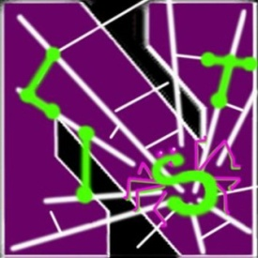
Detecting and Characterizing Social Spam Campaigns
Hongyu Gao, Jun Hu, Christo Wilson, Zhichun Li, Yan Chen and Ben Y. Zhao
Northwestern University, US
Northwestern / Huazhong Univ. of Sci & Tech, China
University of California, Santa Barbara, US
NEC Laboratories America, Inc., US

Slide 2
Background
Notes:
Online social network has become extremely popular among Internet users.
Facebook, the largest online social network:
1. 400M (now 500M) active users.
2. The most visited website, accounting for 7.07% of visits.
Mar. 17, 2010, Facebook surpassed Google in weekly U.S. hits to become the most visited website, accounting for 7.07% of visits.

Slide 3
Benign post1
Benign post2
Benign post3
…
…
Benign post1
Benign post2
…
…
…
Benign post1
Benign post2
Benign post3
…
…
…
…
Benign post1
Benign post2
…
…
…
Benign post1
Benign post2
…
…
Benign post1
Benign post2
Notes:
Let’s take a quick look on how facebook works.
In facebook, millions of interconnected users form a huge social graph. An edge in the graph means the two corresponding users have established a friend relation. Each of the users is associated with his wall. The primary form of message exchange in facebook is called the wall posts. Users can make wall posts to others’ walls over the social graph.

Slide 4
Secret admirer reveald. Go here to find out who …
Notes:
While people are enjoying the convenience facebook brings to them,
you may have seen such report about the spreading of Koobface worm across facebook.
Or you might have received such a weird message asking you to reveal your secret admirer.
In addition, popular OSNs have become the target of phishing attacks and account credentials are being sold in underground forums.
These anecdotal stories have been there for quite a while. We know that something bad is happening in the OSNs.
However, except for the twitter spam paper just presented in CCS this year, there is no systematic analysis on nowadays online social network, to
Reveal what kind of bad things is happening, why and how it is happening, and how bad the situation is.
Our research targets to fill this void.

Slide 5
Contributions
Conduct the largest scale experiment on Facebook to confirm spam campaigns.
3.5M user profiles, 187M wall posts.
Uncover the attackers’ characteristics.
Mainly use compromised accounts.
Mostly conduct phishing attack.
Release the confirmed spam URLs, with posting times.
http://list.cs.northwestern.edu/socialnetworksecurity
http://current.cs.ucsb.edu/socialnets/

Slide 6
Roadmap
Detection System Design
Validation
Malicious Activity Analysis
Conclusions
6
Notes:
6
Next in this talk, I will first give our detailed system design that tries to detect malicious activities in Online social networks, followed by ….

Slide 7
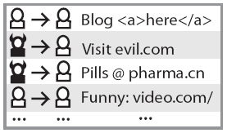
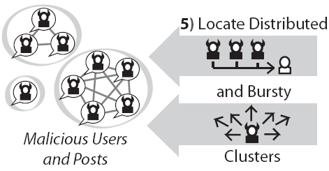
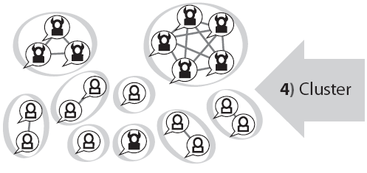
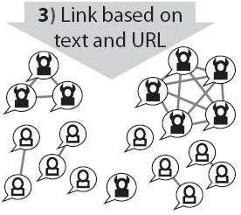
System Overview
Identify coordinated spam campaigns in Facebook.
Templates are used for spam generation.
Notes:
Crawl wall posts from facebook.
Filter out wall posts without URLs and keep the ones with URLs for further processing. That is to say, that we only focus our detection on spams containing URLs. We made this choice because 1) the majority of spams contain the URL that the attacker wants the recipient to go to; 2) If we want to handle other form of spams, we just have to implement a module that can identify the goal of the spammer in other forms, for example, the stock share the spammer wants the recipient to buy, the phone number the spammer wants the recipient to call, etc. And plug this module into the system.
Next, we compare the remaining wall posts and link similar ones together, based on their text and contained URLs.
After that, we do clustering to group all connected wall posts together.
Finally, we adopt a commonly used filter in spam detection to distinguish the malicious cluster from the benign ones.

Slide 8
Build Post Similarity Graph
Go to evil.com!
Check out funny.com
A node: an individual wall post
An edge: connect two “similar” wall posts
Notes:
An edge resembles that the pair of nodes are coming from the same spam campaign.
Of course we don’t have such ground truth in the detection stage.
As a result, we add an edge between two nodes if the two wall posts are “similar”, since the spam wall posts are generated from templates and they should present similarity among them.

Slide 9
Wall Post Similarity Metric
Spam wall post model:
A textual description:
hey see your love
compatibility ! go here
yourlovecalc . com
(remove spaces)
hey see your love
compatibility ! go here
(remove spaces)
yourlovecalc . com
A destination URL:

Slide 10
Wall Post Similarity Metric
Condition 1:
Similar textual description.
Guess who your secret admirer is??
Go here nevasubevd . blogs pot . co m (take out spaces)
Guess who your secret admirer is??
Go here (take out spaces)
“Guess who ”, “uess who y”, “ess who yo”, “ss who you”,
“s who your”, “ who your ”, “who your s”, “ho your se”, …
14131193659701777830, 14741306959712195600,
10922172988510136713, 9812648544744602511, …
996649753058124798, 1893573314373873575,
4928375840175086076, 5186308048176380985, …
Guess who your secret admirer is??”
Visit: yes-crush . com (remove spaces)
Guess who your secret admirer is??”
Visit: yes-crush . com (remove spaces)
“Guess who ”, “uess who y”, “ess who yo”, “ss who you”,
“s who your”, “who your s”, “ho your se”, “o your sec”, …
14131193659701777830, 14741306959712195600,
10922172988510136713, 9812648544744602511, …
996649753058124798, 1893573314373873575,
4928375840175086076, 5186308048176380985, …
Establish an edge!
Notes:
Since templates are used to generated the spams, the textual body may differ here and there, but the major part remains unchanged.
An example is given below. The description is highlighted using the red color….
In our system implementation, we use approximate finger print to compute the similarity between textual descriptions. Describe fingerprint implementation.

Slide 11
Wall Post Similarity Metric
Condition 2:
Same destination URL.
secret admirer revealed.
goto yourlovecalc . com (remove the spaces)
hey see your love compatibility !
go here yourlovecalc . com (remove spaces)
Establish an edge!

Slide 12
Extract Wall Post Campaigns
Intuition:
A
B
B
A
C
B
C
Reduce the problem of identifying potential campaigns to identifying connected subgraphs.
Notes:
We use breadth-first-search to effectively identify all connected subgraphs.

Slide 13
Locate Spam Campaigns
Distributed: campaigns have many senders.
Bursty: campaigns send fast.
Wall post campaign
Distributed?
NO
Benign
YES
YES
Bursty?
NO
Malicious
Benign
Notes:
Distributed property: the cluster is posted by at least n distinct users.
Bursty property: the median interval of two consecutive wall posts is less than t.

Slide 14
Roadmap
Detection System Design
Validation
Malicious Activity Analysis
Conclusions
14
Notes:
14

Slide 15
Validation
Dataset:
Leverage unauthenticated regional network.
Wall posts already crawled from prior study.
187M wall posts in total, 3.5M recipients.
~2M wall posts with URLs.
Detection result:
~200K malicious wall posts (~10%).
Notes:
Affecting 151K users (4.3%).
Malicious users all (~57K) crawled: (6K)

Slide 16
Validation
Focused on detected URLs.
Adopted multiple validation steps:
URL de-obfuscation
3rd party tools
Redirection analysis
Keyword matching
URL grouping
Manual confirmation

Slide 17
Validation
Step 1: Obfuscated URL
URLs embedded with obfuscation are malicious.
Reverse engineer URL obfuscation methods:
Replace ‘.’ with “dot” : 1lovecrush dot com
Insert white spaces : abbykywyty . blogs pot . co m
Notes:
Reverse engineer the common obfuscation techniques to identify the obfuscated URLs.

Slide 18
Validation
Step 2: Third-party tools
Use multiple tools, including:
McAfee SiteAdvisor
Google’s Safe Browsing API
Spamhaus
Wepawet (a drive-by-download analysis tool)
…

Slide 19
Validation
Step 3: Redirection analysis
Commonly used by the attackers to hide the malicious URLs.
URL1
URL1
URL_{M}

Slide 20
Experimental Evaluation
The validation result.

Slide 21
Roadmap
Detection System Design
Validation
Malicious Activity Analysis
Conclusions
21
Notes:
21

Slide 22
Malicious Activity Analysis
Spam URL Analysis
Spam Campaign Analysis
Malicious Account Analysis
Temporal Properties of Malicious Activity
22
Notes:
22

Slide 23
Spam Campaign Topic Analysis
Identifying attackers’ social engineering tricks:
Campaign
Summarized wall post description
Post #
Crush
Someone likes you
45088
Ringtone
Invitation for free ringtones
22897
Love-calc
Test the love compatibility
20623
…
…
…

Slide 24
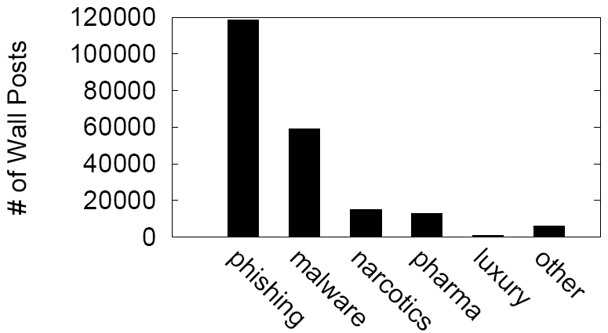
Spam Campaign Goal Analysis
Phishing #1: for money
Phishing #2: for info
Categorize the attacks by attackers’ goals.
Notes:
Narcotics, pharma and luxury stands for the corresponding product selling.

Slide 25
Malicious Account Analysis
Account behavioral analysis:
Sampled manual analysis:

Slide 26
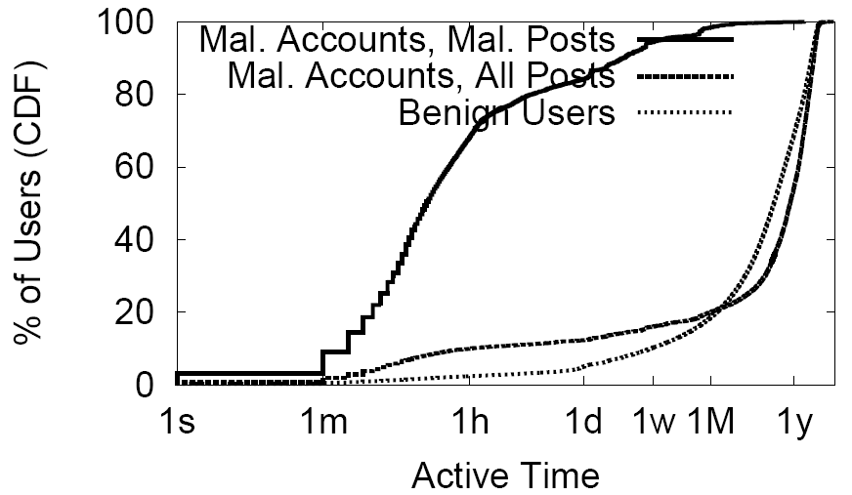
Malicious Account Analysis
Counting all wall posts, the curves for malicious and benign accounts converge.

Slide 27
Roadmap
Detection System Design
Validation
Malicious Activity Analysis
Conclusions
27
Notes:
27

Slide 28
Conclusions
Conduct the largest scale spam detection and analysis on Facebook.
3.5M user profiles, 187M wall posts.
Make interesting discoveries, including:
Over 70% of attacks are phishing attacks.
Compromised accounts are prevailing.

Slide 29
Thank you!
Project webpage:
http://list.cs.northwestern.edu/socialnetworksecurity
http://current.cs.ucsb.edu/socialnets/
Spam URL release:
http://dod.cs.northwestern.edu/imc10/URL_data.tar.gz

Slide 30
Bob’s Wall
Bob
From: Dave
That movie was fun!
From: Chuck
Check out funny.com
From: Chuck
Go to evil.com!
That movie was fun!
Check out funny.com
Go to evil.com!
Chuck
Dave
Chuck
Notes:
In Facebook, suppose Bob registered for an account. His account is associated with a Wall. The primary form of message exchange in Facebook is called “wall post”. People can make wall posts onto others walls. However, at this stage, Bob’s cannot send wall post to anyone yet.
Let there be two other registered users, Chuck and Dave….
Describe motivation in this slide.
This is not our imaginary scene. The Koobface worm exactly uses this mechanism to spread across Facebook. Also, popular OSNs have become targets of phishing attacks and account credentials are being sold in underground forums.

Slide 31
Benign post1
Benign post2
Benign post3
Malicious p1
…
…
Benign post1
Benign post2
…
…
…
Benign post1
Benign post2
Benign post3
Malicious p1
…
…
…
…
…
Benign post1
Benign post2
Malicious p1
Malicious p2
…
…
…
…
…
Benign post1
Benign post2
…
…
…
…
…
Benign post1
Benign post2
Malicious p1
Malicious p2
Notes:
Looking at a bigger picture….
Introduce goals in this slide.
1. Design a systematic approach to effectively detect miscreant activities in OSNs. In particular, we are targeting coordinated spam campaigns. We do not restrict our detection only to the spamming activities for product selling. Rather, no matter what is the purpose of the attacker, phishing, malware spreading, or others, as long as he is sending out coordinated unsolicited messages in large scale, he is the target of the system.
2. Quantitatively analyze and characterize the verified detection result to provide further understanding on these attacks.

Slide 32
Data Collection
Based on “wall” messages crawled from Facebook (crawling period: Apr. 09 ~ Jun. 09 and Sept. 09).
Leveraging unauthenticated regional networks, we recorded the crawled users’ profile, friend list, and interaction records going back to January 1, 2008.
187M wall posts with 3.5M recipients are used in this study.

Slide 33
Filter posts without URLs
Assumption: All spam posts should contain some form of URL, since the attacker wants the recipient to go to some destination on the web.
Example (without URL):
Kevin! Lol u look so good tonight!!!
Filter out

Slide 34
Filter posts without URLs
Assumption: All spam posts should contain some form of URL, since the attacker wants the recipient to go to some destination on the web.
Example (with URL):
Um maybe also this:
http://community.livejournal.com/lemonadepoem/54654.html
Guess who your secret admirer is??
Go here nevasubevd\t. blogs pot\t.\tco\tm (take out spaces)
Further process

Slide 35
Extract Wall Post Clusters
A sample wall post similarity graph and the corresponding clustering result (for illustrative purpose only)

Slide 36
Locate Malicious Clusters
(5, 1.5hr) is found to be a good (n, t) value.
Slightly modifying the value only have minor impact on the detection result.
A relaxed threshold of (4, 6hr) only result in 4% increase in the classified malicious cluster.

Slide 37
Experimental Validation
Step 5: URL grouping
Groups of URLs exhibit highly uniform features. Some have been confirmed as “malicious” previously. The rest are also considered as “malicious”.
Human assistance is involved in identifying such groups.
Step 6: Manual analysis
We leverage Google search engine to confirm the malice of URLs that appear many times in our trace.

Slide 38
URL Analysis
3 different URL formats (with e.g.):
Link: <a href=“...”>http://2url.org/?67592</a>
Plain text: mynewcrsh.com
Obfuscated: nevasubevu . blogs pot . co m
Type | # of URLs | # of Wall Posts | Avg # of Wall posts per URL
Total # | 15,484 | 199,782 | N/A
Obfuscated | 6.5% | 25.3% | 50.3
Plaintext | 3.8% | 6.7% | 22.9
Hypertext link | 89.7% | 68.0% | 9.8

Slide 39
URL Analysis
4 different domain types (with e.g.):
Content sharing service: imageshack.us
URL shortening service: tinyurl.org
Blog service: blogspot.com
Other: yes-crush.com
Type | # of URLs | # of Wall Posts
ContentShare | 2.8% | 4.8%
URL-short | 0.7% | 5.0%
Blogs | 55.6% | 15.8%
Other | 40.9% | 74.4%

Slide 40
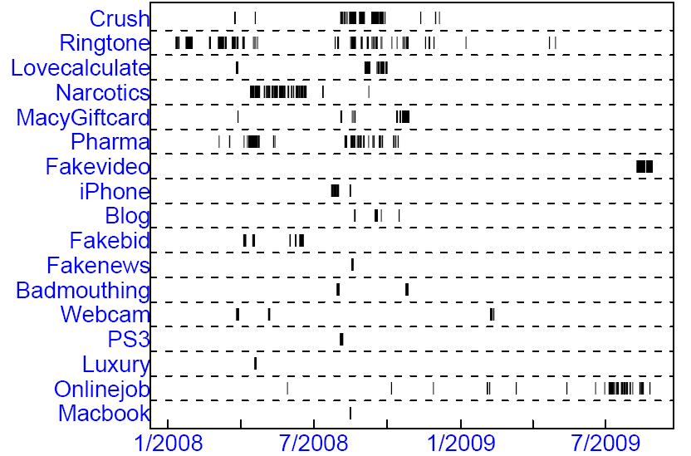
Spam Campaign Temporal Analysis

Slide 41
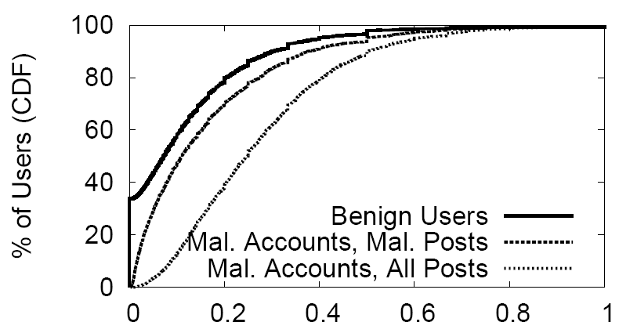
Account Analysis
The CDF of interaction ratio.
Malicious accounts exhibit higher interaction ratio than benign ones.

Slide 42
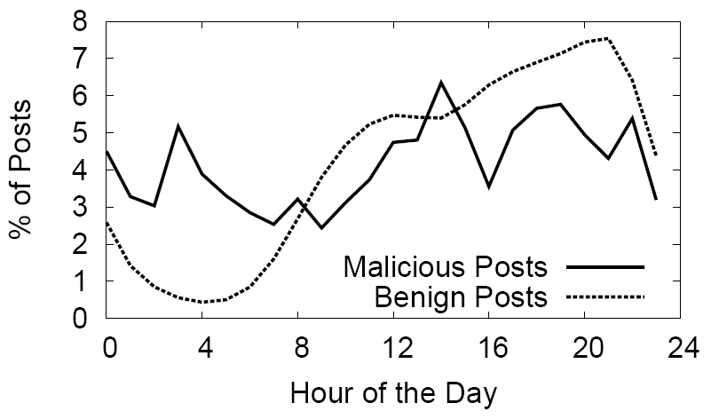
Wall Post Hourly Distribution
The hourly distribution of benign posts is consistent with the diurnal pattern of human, while that of malicious posts is not.

